Slide 1


Event Table
Event | Trigger | Source | Use Case | Response | Destination
VCM and Server Key generates key using Diffie-Hellman Algorithm | Server Key collects all public keys of VCMs | VCM and Server Key | Generate key using Diffie-Hellman Algorithm | Generated Key | VCM
VCM encrypts ER using VCM’s private key | Generated key using Diffie-Hellman Algorithm | VCM | Encrypt ER using private key | Encrypted ER | VCM
VCM gets hash value of ER using three hash function | Encrypted ER | VCM | Hash the ER | Three hash values of ER | VCM
VCM encrypts the encrypted ER and hash values together using the generated key in the Diffie-Hellman Algorithm | Hash values of ER | VCM | Encrypt the encrypted ER and its hash values together | Encrypted encrypted ER and hash values | VCM
VCM sends both the encrypted encrypted ER and its three hash values to Server Key | Encrypted encrypted ER and hash values | VCM | Send both the encrypted encrypted ER and its hash values | Sent encrypted encrypted ER and hash value | Server Key
Server Key receives the data and decrypts it using the Diffie-Hellman Key and the VCM’s public key | Sent encrypted encrypted ER and hash value | Server Key | Decrypt data using Diffie-Hellman Key and VCM’s public key | Decrypted ER and its hash function | Server Key
Server key hashes the decrypted ER | Decrypted data | Server Key | Hash the decrypted ER | Three hash values of the decrypted file | Server key
Server key checks if the generated hash values of the file and the hash values sent by the VCM are the same | Three hash values of the decrypted file | Servery Key | Server key checks if hash values are the same | Verified data | Server Key

Slide 2
Context Diagram
Encrypted data
VCM
Automated Election System
Encrypted data
Servers(CSS,Central and Transparency)
Encrypted data
Encrypted data

Slide 3
DFD DIAGRAM 0
4
encrypts the encrypted ER and hash values together using the generated key in the Diffie-Hellman Algorithm
generated key
2
Encrypts ERs using VCM’s private key
3
Gets hash value of ER using three hash function
Hash value of ER
encrypted ER
1
Generates key using Diffie-Hellman Algorithm
encrypted encrypted ER &
three hash values
Public keys
6
decrypts encrypted ERs using the Diffie-Hellman Key and the VCM’s public key
encrypted encrypted ERs and three hash values
5
sends both the encrypted encrypted ER and its three hash values to Server Key
8
checks if the generated hash values of the ER and the hash values sent by the VCM are the same
hashed decrypted ER
7
hashes the decrypted ER
decrypted ERs

Slide 4
DFD DIAGRAM 1

Slide 5
Activity Diagram
VCM | SERVER
Generates key
Sends both the encrypted encrypted ER and its hash values
Encrypt ER using private key
Decrypts data using Diffie-Helman key and VCM’s public key
Gets hash values of ER
Hash the decrypted ER
checks if the generated hash values of the ER and the hash values sent by the VCM are the same
Encrypts the encrypted ER and its hash values together

Slide 6
Communication Diagram
1:GenerateKey()
5:SendEncryptedER
& HashValue()
:VCM
:Servers
(CCS, Central and Transparency)
2:EncryptERs()
6:DecryptER()
7:HashDecryptedER()
8:CheckHashValues()
3:GetHashValue()
4:EncryptEncryptedER
& HashValue()

Slide 7
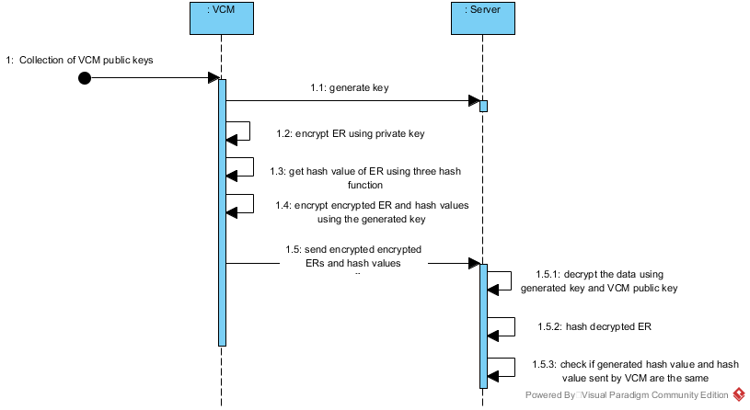
Sequence Diagram

Slide 8
State Diagram
VCM public key
Generate key
Decrypt ER
Hash decrypted ER
Generated key
Generated key
Public key
Encrypt ER
Send encrypted ER and hash values
Check hash values
Encrypted ERs
Get hash value
Generated key
Encrypt encrypted ER and hash values

Slide 9
Timing Diagram
Generate key using DH algorithm
Encrypt ER using VCM public key
Get hash value of ER
Encrypt the encrypted ER and hash values together using the generated key in the Diffie-Hellman Algorithm
|------30s------|--------30s-------|-------30s------|-----------------30s---------------------|
Send encrypted encrypted ERs & hash value
Decrypt encrypted ER using DH key & VCM private key
Hash decrypted ER
Check if generated hash values of the file and the hash values sent by the VCM are the same key
|--------30s---------|-----------30s---------|-------30s-------|----------------30s-----------------|

Slide 10
Interaction Overview Diagram
Sd VoteTransmission

Slide 11
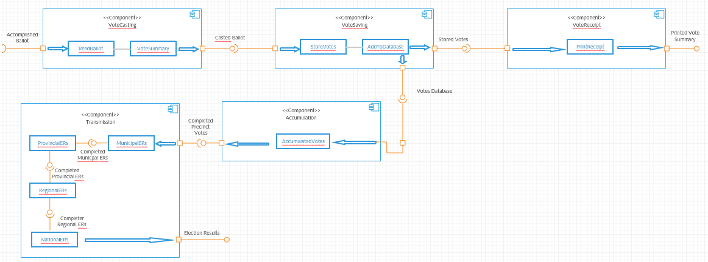
Component Diagram

Slide 12
Composite Diagram
TransmissionVotes
Central Server
VCM
Transparency Server
Hybrid Cryptography of AES
Transparency Server

Slide 13
Use Case Diagram
VCM
Generate key
CCS, Central, Transparency Server

Slide 14
Use Case Diagram
VCM
Encrypt ER

Slide 15
Use Case Diagram
VCM
Get hash value of ER

Slide 16
Use Case Diagram
VCM
Encrypt encrypted ER and hash values

Slide 17
Use Case Diagram
VCM
Send encrypted encrypted ER and three hash values
CCS, Central, Transparency Server

Slide 18
Use Case Diagram
CCS, Central, Transparency Server
Receive data and decrypt ER

Slide 19
Use Case Diagram
CCS, Central, Transparency Server
Hash decrypted ER

Slide 20
Use Case Diagram
CCS, Central, Transparency Server
Verify if hash values matched

Slide 21
Use Case Diagram w Full Description
Use Case Name: | Generate key using Diffie-Hellman Algorithm
Scenario: | CCS, Central Server and Transparency Server sends encrypted data to VCM using the VCM’s public key
Triggering Event: | End of voting period
Brief Description: | The three main servers send a message to the VCM that is encrypted using the VCM’s public key
Actor(s): | VCM, CCS, Central Server, Transparency Server
Related Use Cases: | ---
Stakeholders: | The VCM will receive the data sent by the servers The three servers will have to send the encrypted data
Precondition: | Voting Period closes
Postcondition: | Sent encrypted data
Basic Flow: | Actor: 1. The Comelec closes the voting period | System Response: 1.1 The CCS. Central Server, and the transparency server sends a message to the VCMs to initiate the vote transmissions.
Exceptions: | The machines being used have defects making it impossible to communicate

Slide 22
Use Case Diagram w Full Description
Use Case Name: | Encrypt ER using private key
Scenario: | VCM decrypts the data using its private keys
Triggering Event: | Received encrypted data
Brief Description: | In order for the VCM to read the data sent by the servers, it has to decrypt it using its very own private key.
Actor(s): | VCM, CCS, Central Server, Transparency Server
Related Use Cases: | Generate key using Diffie-Hellman Algorithm
Stakeholders: | The VCMs must decrypt the data using the private key assigned to it
Precondition: | Sent encrypted data
Postcondition: | Decrypted the data
Basic Flow: | Actor: 1. Poll watchers ensure that no one will intervene the transmission process. | System Response: 1.1 The System will decrypt the data that was encrypted and interpret it into a language that is understandable.
Exceptions: | The machines being used have defects making it impossible to communicate. Human intervention is present and the system fails to serve its purpose.

Slide 23
Use Case Diagram w Full Description
Use Case Name: | Hash the ER
Scenario: | VCM & 3 Servers create key exchange using the Diffie-Hellman algorithm
Triggering Event: | Successfully decrypted data
Brief Description: | A security algorithm is used by the VCM and servers in order to generate their own key.
Actor(s): | VCM, CCS, Central Server, Transparency Server
Related Use Cases: | Generate key using Diffie-Hellman Algorithm Encrypt ER using private key
Stakeholders: | The VCM and servers must create a key
Precondition: | Decrypted the data
Postcondition: | Generated Key
Basic Flow: | Actor: 1. Poll watchers ensure that no one will intervene the transmission process. | System Response: 1.1 VCM and secret servers will communicate with each other 1.2 They will be able to generate a key exchange.
Exceptions: | The machines being used have defects making it impossible to communicate. Human intervention is present and the system fails to serve its purpose.

Slide 24
Use Case Diagram w Full Description
Use Case Name: | Encrypt the encrypted ER and its hash values together
Scenario: | VCM sends encrypted election returns using the generated key
Triggering Event: | Generated Key
Brief Description: | After the key exchange, the VCM will transmit the ERs that were encrypted using the generated key.
Actor(s): | VCM, CCS, Central Server, Transparency Server
Related Use Cases: | Generate key using Diffie-Hellman Algorithm Encrypt ER using private key Hash the ER
Stakeholders: | VCM should transmit encrypted ERs to the servers that communicated to it.
Precondition: | Generated Key
Postcondition: | Sent encrypted ERs
Basic Flow: | Actor: 1. Poll watchers ensure that no one will intervene the transmission process. | System Response: 1.1 The VCM will transmit encrypted votes to the servers. 1.2 Servers will receive them
Exceptions: | The machines being used have defects making it impossible to communicate. Human intervention is present and the system fails to serve its purpose.

Slide 25
Use Case Diagram w Full Description
Use Case Name: | Send both the encrypted encrypted ER and its hash values
Scenario: | CCS, Central Server and, Transparency Server verify hash value of the received election returns
Triggering Event: | Completion of Precinct Votes
Brief Description: | Received encrypted election returns
Actor(s): | VCM, CCS, Central Server, Transparency Server
Related Use Cases: | Generate key using Diffie-Hellman Algorithm Encrypt ER using private key Hash the ER Encrypt the encrypted ER and its hash values together
Stakeholders: | Servers will determine if the hash values are authentic
Precondition: | Sent encrypted ERs
Postcondition: | Verified Hash Value
Basic Flow: | Actor: 1. Poll watchers ensure that no one will intervene the transmission process. | System Response: 1.1 The servers will check the ER’s integrity by looking at the hash code. 1.2 Servers will now include the data in the official count of the votes if the hash codes matches. 1.3 In the event that there was an anomaly in the hash, the servers won’t accept the data thus calling the attention of the administrators.
Exceptions: | The machines being used have defects making it impossible to communicate. Human intervention is present and the system fails to serve its purpose.

Slide 26
Use Case Diagram w Full Description
Use Case Name: | Decrypt data using Diffie-Hellman Key and VCM’s public key
Scenario: | CCS, Central Server and, Transparency Server verify hash value of the received election returns
Triggering Event: | Completion of Precinct Votes
Brief Description: | Received encrypted election returns
Actor(s): | VCM, CCS, Central Server, Transparency Server
Related Use Cases: | Generate key using Diffie-Hellman Algorithm Encrypt ER using private key Hash the ER Encrypt the encrypted ER and its hash values together Send both the encrypted encrypted ER and its hash values
Stakeholders: | Servers will determine if the hash values are authentic
Precondition: | Sent encrypted ERs
Postcondition: | Verified Hash Value
Basic Flow: | Actor: 1. Poll watchers ensure that no one will intervene the transmission process. | System Response: 1.1 The servers will check the ER’s integrity by looking at the hash code. 1.2 Servers will now include the data in the official count of the votes if the hash codes matches. 1.3 In the event that there was an anomaly in the hash, the servers won’t accept the data thus calling the attention of the administrators.
Exceptions: | The machines being used have defects making it impossible to communicate. Human intervention is present and the system fails to serve its purpose.

Slide 27
Use Case Diagram w Full Description
Use Case Name: | Hash the decrypted ER
Scenario: | CCS, Central Server and, Transparency Server verify hash value of the received election returns
Triggering Event: | Completion of Precinct Votes
Brief Description: | Received encrypted election returns
Actor(s): | VCM, CCS, Central Server, Transparency Server
Related Use Cases: | Generate key using Diffie-Hellman Algorithm Encrypt ER using private key Hash the ER Encrypt the encrypted ER and its hash values together Send both the encrypted encrypted ER and its hash values Decrypt data using Diffie-Hellman Key and VCM’s public key
Stakeholders: | Servers will determine if the hash values are authentic
Precondition: | Sent encrypted ERs
Postcondition: | Verified Hash Value
Basic Flow: | Actor: 1. Poll watchers ensure that no one will intervene the transmission process. | System Response: 1.1 The servers will check the ER’s integrity by looking at the hash code. 1.2 Servers will now include the data in the official count of the votes if the hash codes matches. 1.3 In the event that there was an anomaly in the hash, the servers won’t accept the data thus calling the attention of the administrators.
Exceptions: | The machines being used have defects making it impossible to communicate. Human intervention is present and the system fails to serve its purpose.

Slide 28
Use Case Diagram w Full Description
Use Case Name: | Server key checks if hash values are the same
Scenario: | CCS, Central Server and, Transparency Server verify hash value of the received election returns
Triggering Event: | Completion of Precinct Votes
Brief Description: | Received encrypted election returns
Actor(s): | VCM, CCS, Central Server, Transparency Server
Related Use Cases: | Generate key using Diffie-Hellman Algorithm Encrypt ER using private key Hash the ER Encrypt the encrypted ER and its hash values together Send both the encrypted encrypted ER and its hash values Decrypt data using Diffie-Hellman Key and VCM’s public key Hash the decrypted ER
Stakeholders: | Servers will determine if the hash values are authentic
Precondition: | Sent encrypted ERs
Postcondition: | Verified Hash Value
Basic Flow: | Actor: 1. Poll watchers ensure that no one will intervene the transmission process. | System Response: 1.1 The servers will check the ER’s integrity by looking at the hash code. 1.2 Servers will now include the data in the official count of the votes if the hash codes matches. 1.3 In the event that there was an anomaly in the hash, the servers won’t accept the data thus calling the attention of the administrators.
Exceptions: | The machines being used have defects making it impossible to communicate. Human intervention is present and the system fails to serve its purpose.

Slide 29
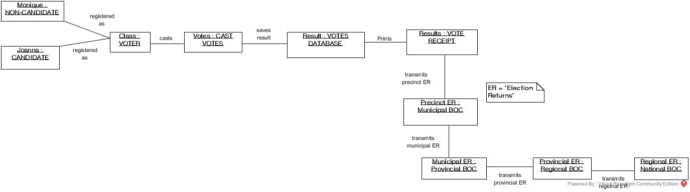
Object Diagram

Slide 30
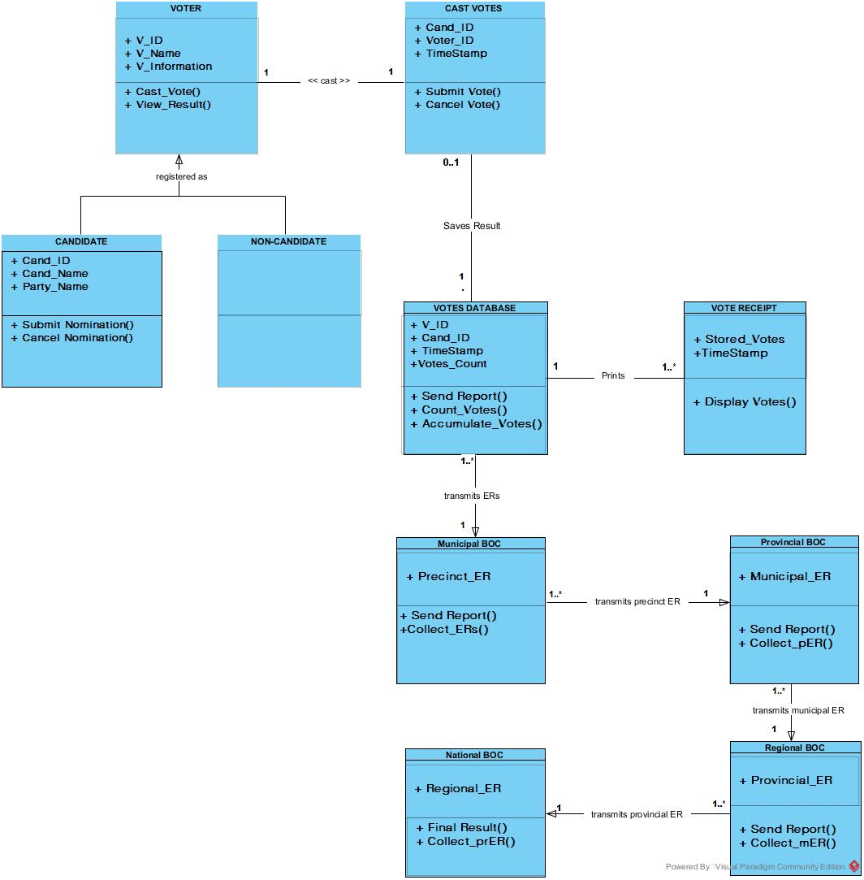
Class Diagram

Slide 31
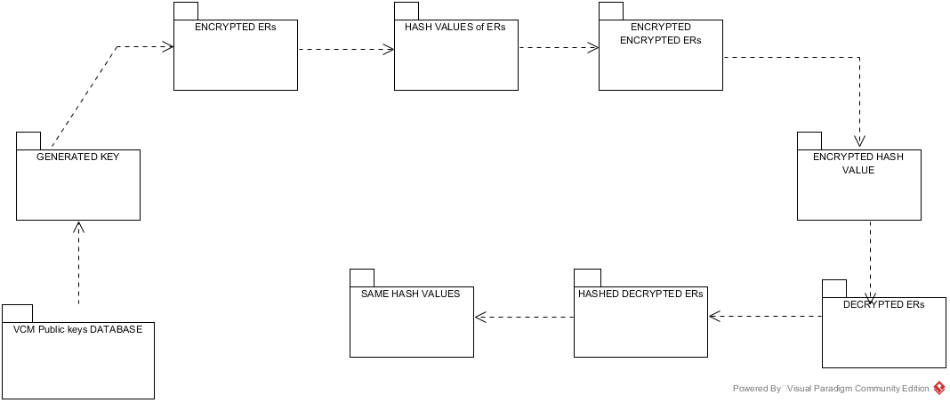
Package Diagram

Slide 32
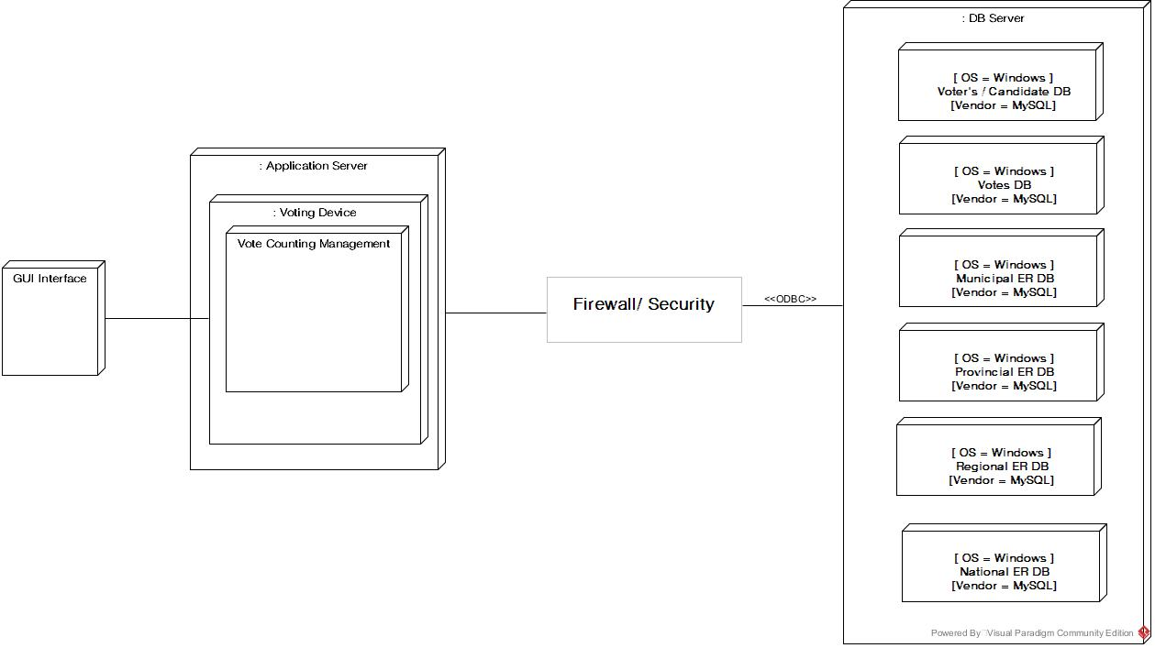
Deployment Diagram

